Slide 1
Global Corporate Fast Facts
SAP Image ID
#274682

Slide 2
SAP Image ID
#275317
77% of the world’s transaction revenue touches an SAP system.

Slide 3
SAP Image ID
# 278033
Singapore
85% of the world’s business to business transaction revenue touches an SAP system.

Slide 4
SAP Image ID
#274948
SAP customers represent 92% of Forbes Global 2000 companies.

Slide 5
SAP Image ID
#273675
80% of our customers are small and midsize enterprises using SAP software to solve business challenges.

Slide 6
SAP Image ID
#272415
SAP systems touch
$23 trillion of consumer purchases around the world.
note: $ currency amount is in USD

Slide 7
SAP Image ID
#272120
SAP customers represent 98% of the top 100 most valued brands in the world.
Notes:
Updated 10/12 – remained at 85%

Slide 8
SAP Image ID
#272409
Our customers produce more than 63% of the world’s brand-name jeans.

Slide 9
SAP Image ID
#272668
Our customers produce more than 86% of the world’s athletic footwear.

Slide 10
SAP Image ID
#274596
Our customers produce 77% of the world’s beauty and fragrance products.

Slide 11
SAP Image ID
#274965
Our customers produce more than 82% of the coffee and tea we drink each day.

Slide 12
SAP Image ID
#275023
Our customers produce more than 77% of the world’s beer.

Slide 13
SAP Image ID
#273504
Our customers distribute more than 78% of the world’s food.

Slide 14
SAP Image ID
#274594
Our customers produce more than 64% of the world’s ice cream.

Slide 15
SAP Image ID
#275048
Our customers produce more than 79% of the world’s chocolate.

Slide 16
SAP Image ID
#274593
Our customers produce 85% of the world’s pet food.

Slide 17
SAP Image ID
#275076
Our customers produce more than 69% of the world’s toys and games.
Notes:
42-20962228

Slide 18
SAP Image ID
#274555
Our customers produce more than 62% of the world’s movies.

Slide 19
SAP Image ID
#274592
SAP customers deliver 74% of radio and TV
broadcasting content worldwide.

Slide 20
SAP Image ID
#275077
Our customers produce more than 82% of the world’s motorcycles.

Slide 21
SAP Image ID
#275652
Our customers manufacture more than 180,000 automobiles per day.

Slide 22
SAP Image ID
ID 275674
Our customers manufacture more than 50,000 commercial vehicles every day.

Slide 23
SAP Image ID
#273058
Our customers distribute more than 76% of the world’s healthcare products.

Slide 24
SAP Image ID
#273179
Our customers produce the top 20 global prescription drugs.

Slide 25
SAP Image ID
#272126
Our customers produce more than 82% of the world’s medical devices.

Slide 26
SAP Image ID
#274597
SAP provides solutions to 58% of United Nations member governments to help improve citizen services.

Slide 27
SAP Image ID
ID 273467
Our customers produce more than 2.5 million tonnes
of steel every day.

Slide 28
SAP Image ID
#272502
SAP connects more than 3.1 million companies in 180 countries in the Ariba Network, the world’s largest business-to-business network.

Slide 29
SAP Image
ID 276603
Our customers produce more than 78 million barrels of oil each day.

Slide 30
SAP Image ID
#273496
Our customers produce 70% of the world’s gold.

Slide 31
SAP Image ID #275697
Analytics solutions from SAP help track more than 6 billion U.S. stock trades per day to identify fraud and protect investors.
Notes:
http://articles.marketwatch.com/2012-05-08/markets/31622887_1_stock-volume-average-daily-volume-largest-trading-volume
Nyse ave daily volume 3.78
Nasdaq 1.75

Slide 32
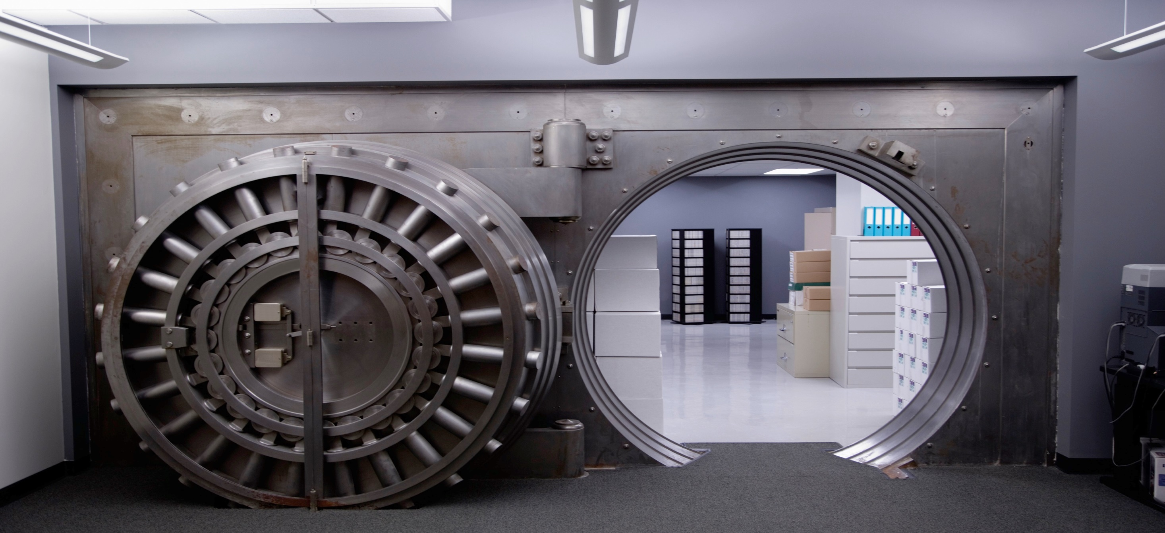
SAP Image ID
#275699
Our global banking customers
manage more than $70 trillion in assets.
note: $ currency amount is in USD

Slide 33
Summary: Time-Based Fast Facts
Every 60 seconds
SAP customers produce …
12,600 kilograms of chocolate
2,800 pairs of athletic shoes
17,200 liters of ice cream
54,200 barrels of oil
282,000 liters of beer
3,800 grams of gold
SAP solutions touch …
$41.8 million consumer purchases
1.25 million mobile messages
4.1 million stock trades analyzed
$9.5 million manufactured goods
$1.9 million B2B commerce exchanges
Every 60 seconds
SAP customers generate … global private sector gross domestic product (GDP)
$74.2 million globally
by region
Asia-Pacific $17.3 million
Europe $22.2 million
Latin America $6.8 million
Middle East and Africa $4.3 million
North America $23 million
by industry
manufacturing $15.9 million
energy and natural resources $8.1 million
financial services $6.6 million
retail and wholesale $7.8 million
healthcare and life sciences $3.6 million
service industries $32.3 million
Every 24 hours
Concur solutions process …
410,000 billable transactions
1 million mobile logins
580,000 mobile expense receipt uploads
158,000 business trips
357,000 expense reports
SAP Fieldglass solutions process …
35,600 timesheets for external workers
1,600 flexible work job postings
400 Statements of work
11,200 integrations
9,500 new users
The Ariba Network processes …
$2.7 billion B2B commerce exchanges
45,000 matched sales leads
$724 million new sourcing opportunities
300,000 purchase orders and invoices
$29 million on-time payments with remittance information
See appendix for alternative “customers produce …” summary slide without beer fact

Slide 34
Summary: SAP Employees Facts
Employee totals
More than 84,100 SAP employees from 154 nations
Africa: 670+, Asia: 22,600+, Australia and New Zealand:1,300+, Europe: 32,900+, Latin America: 3,900+, North America: 19,900+, and 8 other regions
Employee facts
19% of our employees work from home as virtual employees
More than 10% of our office-based employees walk or bike to work.
More than 30% of our office-based employees use public transportation or car-sharing to get to the office.
Employees from 90 nations work at our global headquarters in Walldorf
More than 32% of our employees are women
More than 24% of our management leadership are women
Five generations of employees work at SAP
More than 57,200 of our employees are working parents
More than 43% of our employees are Millennials
In 2016, SAP won more than 159 best employer awards
In 2016, SAP employees volunteered 339,000 hours to create positive social change in their communities.
In 2016, 230 SAP employees took social sabbaticals to help solve challenges for social enterprises in emerging markets
Committed to helping the next generation
Nearly 30% of our new employees are just starting their careers
SAP University Alliances supports more than 2,900 institutions from over 100 countries
In 2016, SAP Africa Code Week trained 426,758 youth in 30 African nations
Dedicated to innovation
More than 23,300 SAP employees work in research and development driving solution innovations
Our employees in research and development work at more than 100 development locations across the world to drive solution innovations
19 SAP Labs lead global research and development to drive core product innovations
12 SAP Innovation Center Network locations are pioneering disruptive technologies and unconventional ideas to identify new game-changing solutions
14 SAP Co-Innovation Labs enable project-based co-innovation with our partners

Slide 35
SAP Business Application Evolution
BW
Business Suite 7.0
ERP / ECC
CRM
SCM
PLM
SRM
SAP NetWeaver
Enterprise Service Oriented Architecture
mySAP.com
One Step
Business
R/3
Client/Server
R/2
Mainframe
R/1
Mainframe
1972
1979
1992
1999/2000
2004
2009
System of Record
Companies adapt to IT IT adapts to processes IT centers on people

Slide 36
SAP Business Application Revolution
SAP on HANA
Enterprise Application
Consumer Apps
Real Time Data Platform
BW on HANA
Suite on HANA
SAP ERP powered by SAP HANA
SAP CRM powered by SAP HANA
SAP PLM powered by SAP HANA
SAP SCM powered by SAP HANA
SAP SRM powered by SAP HANA*
BW
Business Suite 7.0
ERP / ECC
CRM
SCM
PLM
SRM
SAP NetWeaver
Enterprise Service Oriented Architecture
mySAP.com
One Step
Business
R/3
Client/Server
R/2
Mainframe
R/1
Mainframe
1972
1979
1992
1999/2000
2004
2009
2012
System of Engagement
Companies adapt to IT IT adapts to processes IT centers on people IT adopts to Companies

Slide 37
SAP Leonardo Innovate
Achieve measurable value in weeks, not years
Solution Ideation & Vision
Rapid Prototyping
Integration Blueprint
Business Case Development
Global SAP Leonardo Centers for design thinking and innovation
Bring innovative ideas to life; iterate and refine with SAP Build
Create technology roadmap, identify dependencies & remediate risks
Create, test & refine business case for ROI and strategic value
Quickly move from brainstorming to blueprint
Notes:
Design thinking has become the standard by which companies find solutions and create value.
Design thinking is also known as human-centered design, putting the user or customer first.
SAP is working with the design community to build on this foundation and create something we call process-centered design.
This approach find the key leverage points in a business process that can be transformed with exponential technologies while serving the human needs and aspirations of its stakeholders.
(CRISPR and the process of gene editing is a useful thought model)
Like Leonardo DiVinci, who was both an artist and a scientist, Design Thinking draws upon both logic and imagination to solve complex problems…and SAP will bring our expertise in Design Thinking to our customers to help them solve the complex problems of becoming Digital.
As you probably know, SAP has received more than a dozen design recognitions from some of the most prestigious organizations in the world, including multiple Red Dot Awards and recognitions from Fast Company’s Innovation by Design.
At Sapphire, we will introduce Leonardo Innovation Services – aligned to specific use cases, by industry. These are being introduced as fixed price, fixed duration, fixed outcome services…designed to quickly move from innovation to a blueprint for implementation at scale, with a compelling business case.
Customers tell us that IBM Watson requires far too much Services investment, so we want to be clear with our customers that this approach is a differentiator for SAP.

Slide 38
– Digital Innovation System
Applications
Customer
SAP
Partner
Design Led Innovation
Solution Ideation
& Vision
Rapid
Prototyping
Integration Blueprint
Business Case Development
SAP SuccessFactors
Rich
Security
Mobile
Integration
Analytics
Business Services
UX & Collaboration
. . .
S4/HANA
Data Intelligence
Analytics
SAP Ariba
Blockchain
Internet of Things
Machine Learning
Big Data
Business Services
Open
SAP Cloud Platform
Microservices | Open APIs | Flexible Runtimes | Integration
AWS S3
SAP HANA | SAP Data Hub | SAP Vora | Open Source Storages
SAP Database & Data Management
SWIFT
Hadoop
SAP
…
Multi-Cloud Infrastructure
Notes:
Hybrid Needs Integration
SaaS Needs PaaS
Technologies Enable Transformation
Infuse Innovation to Business Processes
New Approach: Design Thinking
Open Innovation: Co-Innovate with the ecosystem
Intelligently connecting people, things, and businesses …

